Slide 1
K FOLD

Slide 2
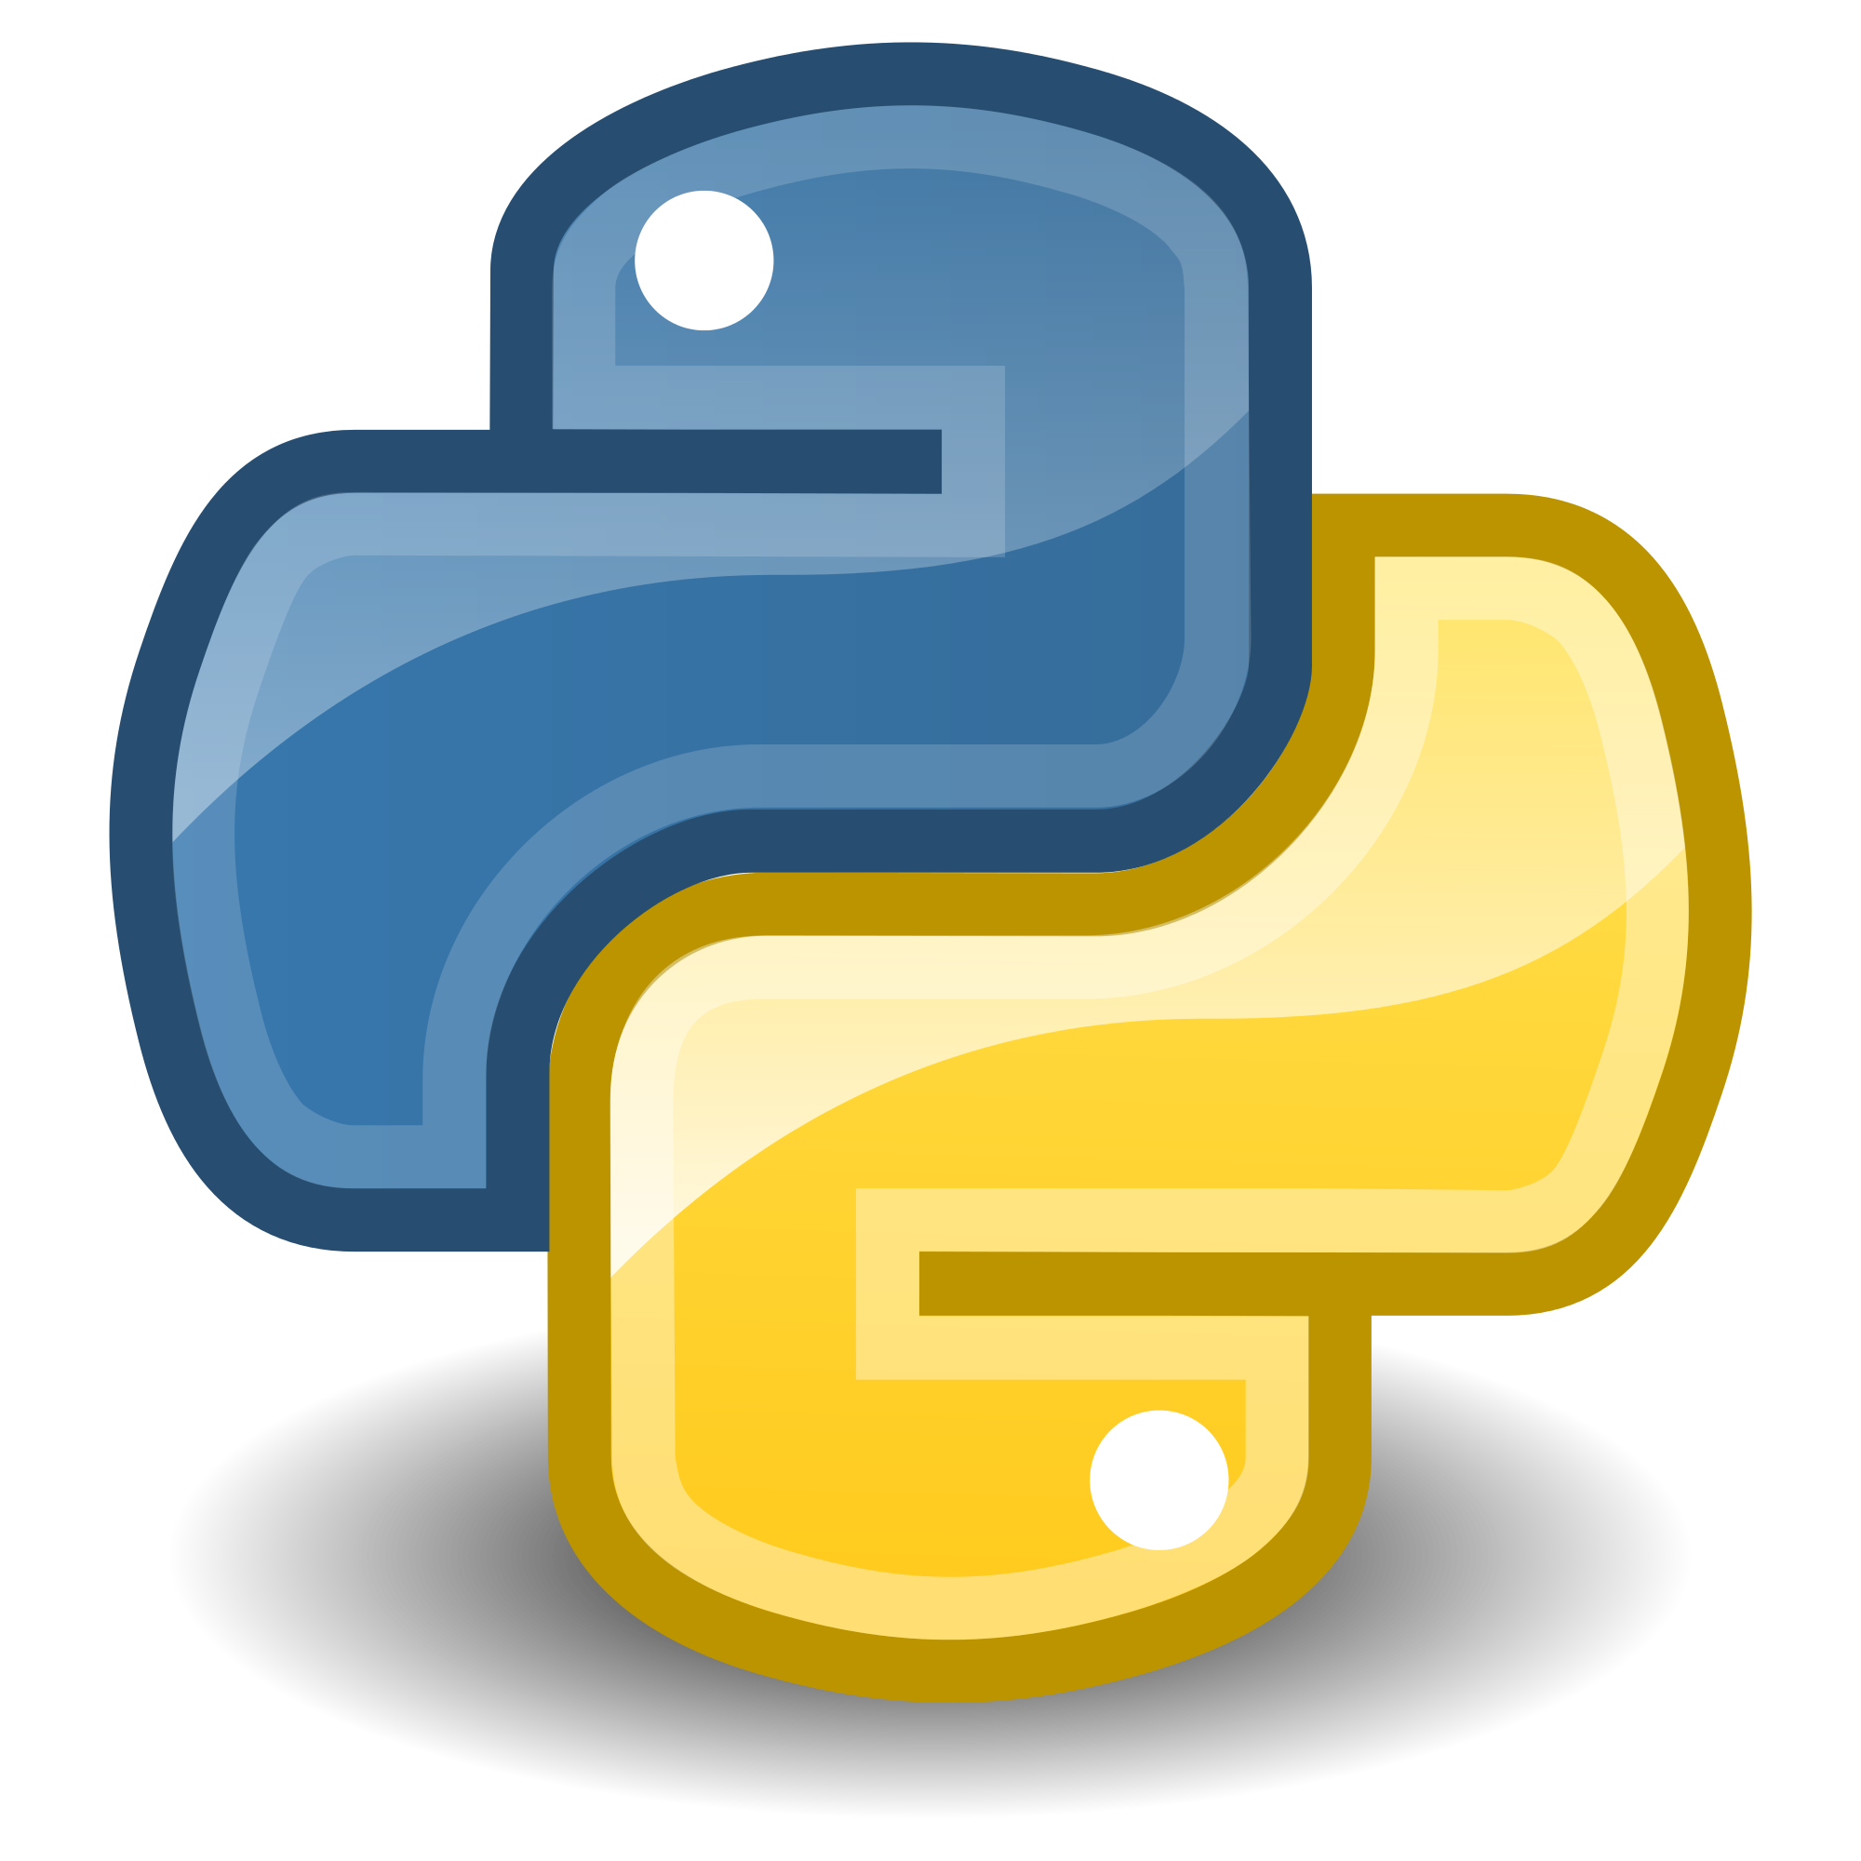
Python

Slide 3
Read file
from tkinter import *
from tkinter.filedialog import askopenfilename
root = Tk()
root.withdraw()
root.update()
file_path = askopenfilename()
root.destroy()

Slide 4
Import libraries
import pandas as pd
import numpy as np
import matplotlib.pyplot as plt

Slide 5
Import dataset
dataset = pd.read_csv(file_path)
X = dataset.iloc[:, [2, 3]].values
y = dataset.iloc[:, 4].values

Slide 6
Train test split
# Splitting the dataset into the Training set and Test set
from sklearn.model_selection import train_test_split
X_train, X_test, y_train, y_test = train_test_split(X, y, test_size = 0.25, random_state = 0)

Slide 7
Feature scaling
from sklearn.preprocessing import StandardScaler
sc = StandardScaler()
X_train = sc.fit_transform(X_train)
X_test = sc.transform(X_test)

Slide 8
Fitting model
from sklearn.svm import SVC
classifier = SVC(kernel = 'rbf', random_state = 0)
classifier.fit(X_train, y_train)

Slide 9
Applying k-Fold Cross Validation
from sklearn.model_selection import cross_val_score
accuracies = cross_val_score(estimator = classifier, X = X_train, y = y_train, cv = 10 , scoring="accuracy")
accuracies.mean() #to get mean of all acurracies
accuracies.std() #to get standard deviation of all accuracies

Slide 10
Printing the results
scores = accuracies
print("Accuracy: %0.2f (+/- %0.2f)" % (scores.mean(), scores.std() * 2))

Slide 11
GRID SEARCH
from sklearn.model_selection import GridSearchCV
parameters = [{'C': [1, 10, 100, 1000], 'kernel': ['linear']},
{'C': [1, 10, 100, 1000], 'kernel': ['rbf'], 'gamma': [0.1, 0.2, 0.3, 0.4, 0.5, 0.6, 0.7, 0.8, 0.9]}]
grid_search = GridSearchCV(estimator = classifier,
param_grid = parameters,
scoring = 'accuracy',
cv = 10,
n_jobs = -1)
grid_search = grid_search.fit(X_train, y_train)

Slide 12
GRID SEARCH OUTPUT
best_accuracy = grid_search.best_score_
best_parameters = grid_search.best_params_

Slide 13

R

